Slide 1
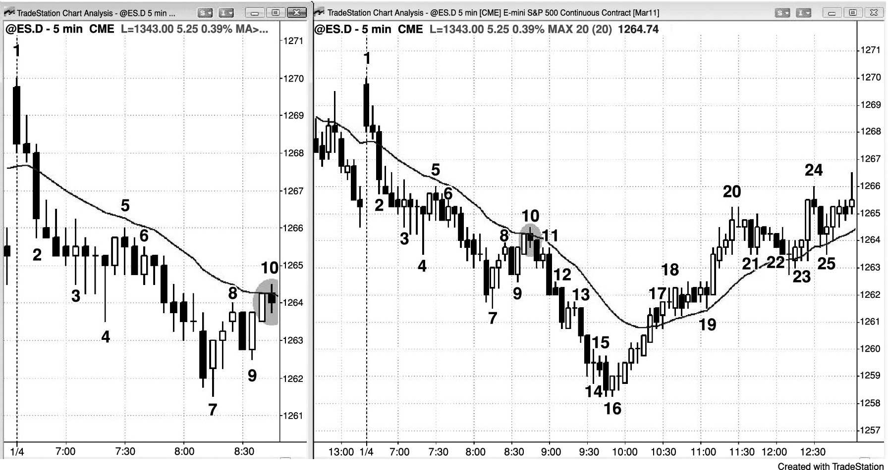
FIGURE PIII.1 Pullbacks Begin with Reversals

Slide 2
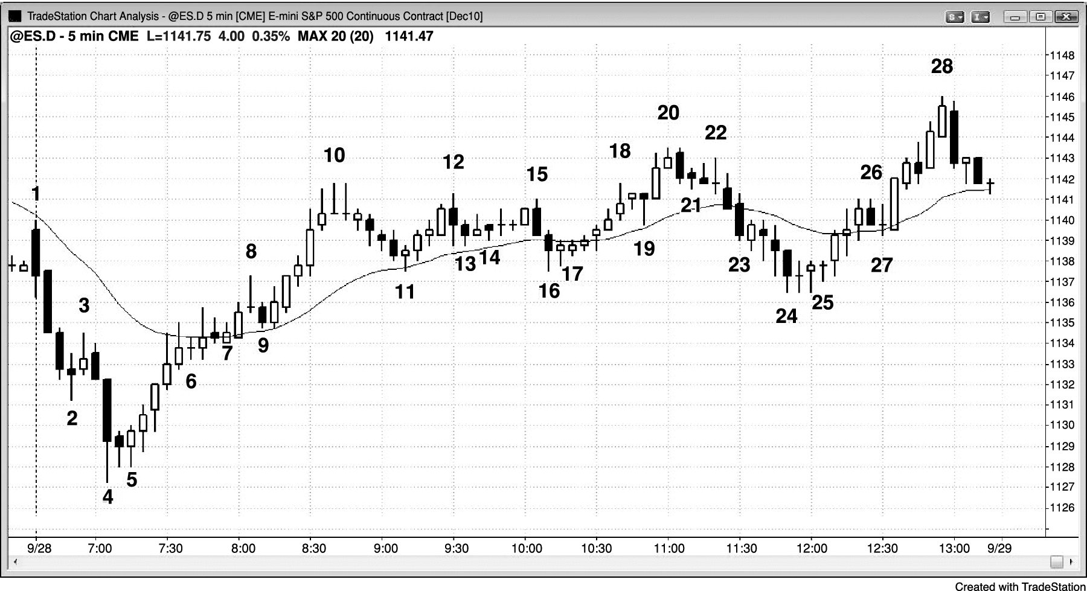
FIGURE PIII.2 Every Pullback Begins with a Reversal

Slide 3
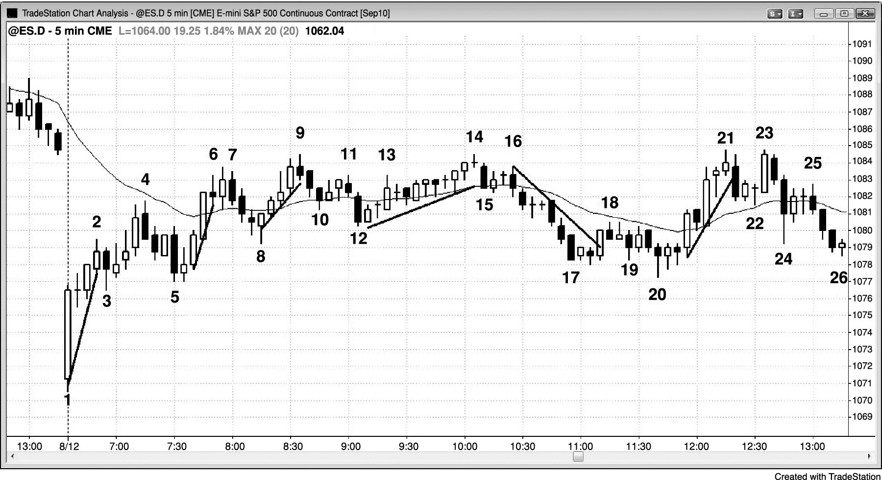
FIGURE PIII.3 Breakout Pullbacks

